Slide 1
External Libraries / Capstone Coding Project

Slide 2
External Libraries
Regardless of what language your students are working in, there will be some code that isn’t included in the core language, that can be added and be used by students.
Some learning around how this works has several benefits for learning:
Exposure to how the open-source community shares and supports
Students learn how to read documentation and distill how to use someone else’s code
Seeing what types of libraries are available can spark some excellent major project ideas.

Slide 3
What and When
In the past, I’ve spent one class on a lesson/demo of using external libraries.
Timing should be likely in the second half of the term.
Should have already have some experience with objects and classes
At least a few weeks before starting the Capstone Coding Project

Slide 4
Demo
Start by looking at the Contribution Manager (or similar) if available in your chosen environment to see what is available that way.
May highlight categories and specific libraries that have been used by students in the past
Sound, Graphical User Interface, Images/Animation, I/O, 3D, Data
As a class, install and try out one. I typically start with Minim
Install Minim
As a class, look at the Quickstart Website and try some sample code
As a class, look at the Reference Website
If time allows, we’ll try out a couple more libraries as a class, or students are given 15 minutes to pick a few to install and experiment with.

Slide 5
Capstone Coding Project
Students are given roughly one month to create a project of their choosing.
Initial deliverable is a proposal
Needs to include a list of must-have and nice-to-have features.
Allows for an early opportunity to vet or refine ideas, or to help guide students to resources.
During the last few days of class, students will individually present/share their project with the rest of the class.

Slide 6
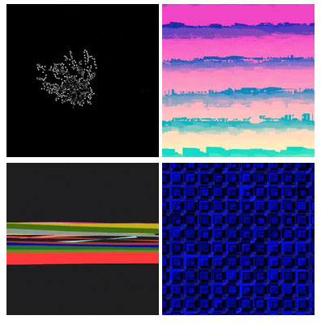
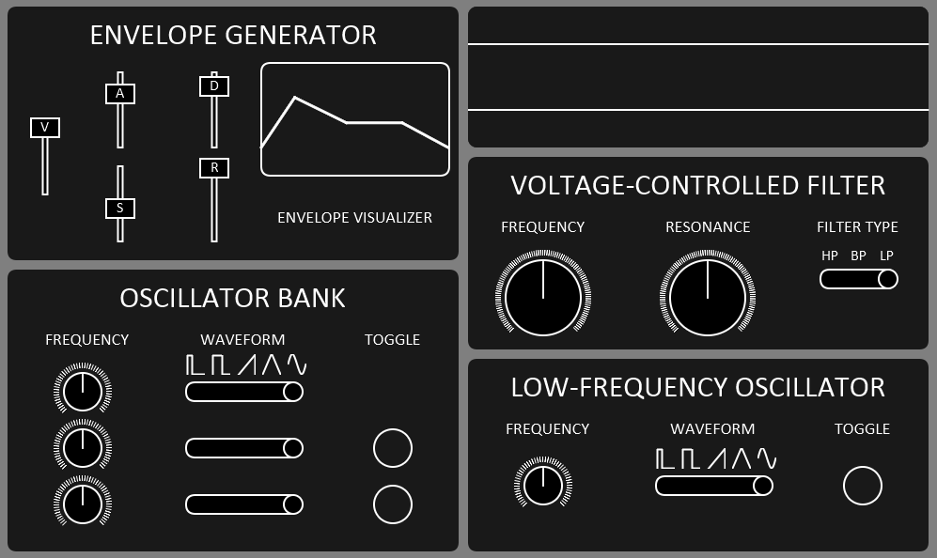
Student Work
The following are some examples of project’s that students created. The source code will be provided so that you can look through and try these programs yourself.
Audio Visualizer Synthesizer (interfaces with MIDI keyboard)

Slide 7
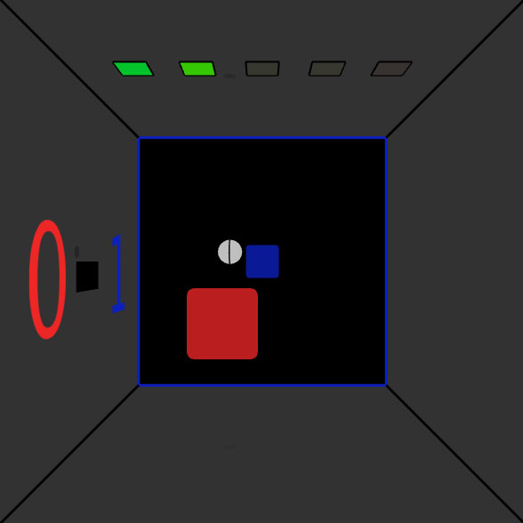

Student Work
Solar System Simulation 3D Pong

Slide 8
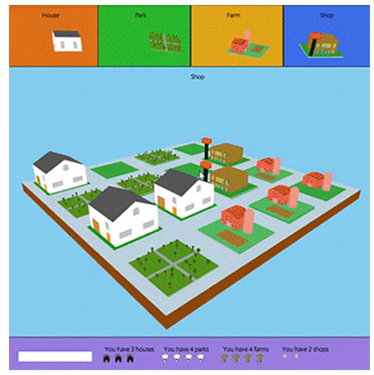
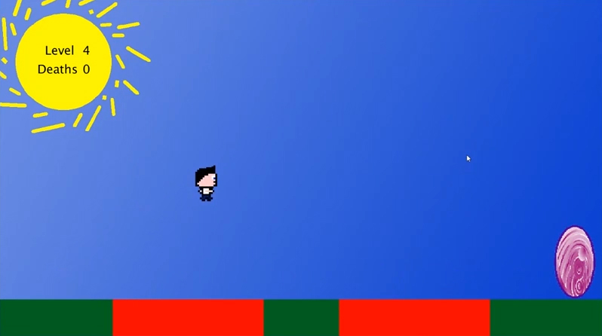
Student Work
Town Builder Platformer

Slide 9
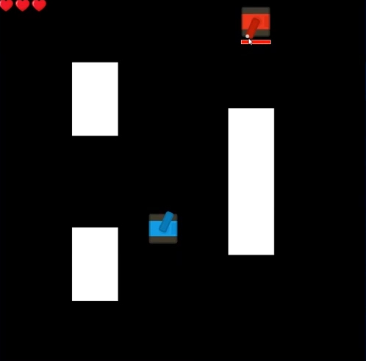
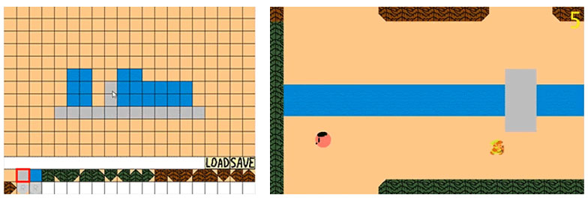
Student Work
Tank Game (AI topics) Top-Down Game + Mapmaker

Slide 10
Presentations
Presentations happen during the last few days of class, with a max time of seven minutes per student.
Students will typically:
Explain the Premise (May use slides)
Demo the Program
Discuss Challenges or Interesting aspects of the project
May show some of their code
Answer 1-2 questions

Slide 11
Assessment
Student projects are assessed in 5 areas:
Complexity
Style
Inline Comments and Header
Reliability
Overall Impression and Features
This rubric is available on GitHub

Slide 12
Time to Explore
In the environment of your choice, experiment with installing some external libraries.
Download some Capstone Coding Projects and try them out.
At the top of the code, any necessary library will be listed
Discuss thoughts / ideas with your neighbours.

